Slide 1
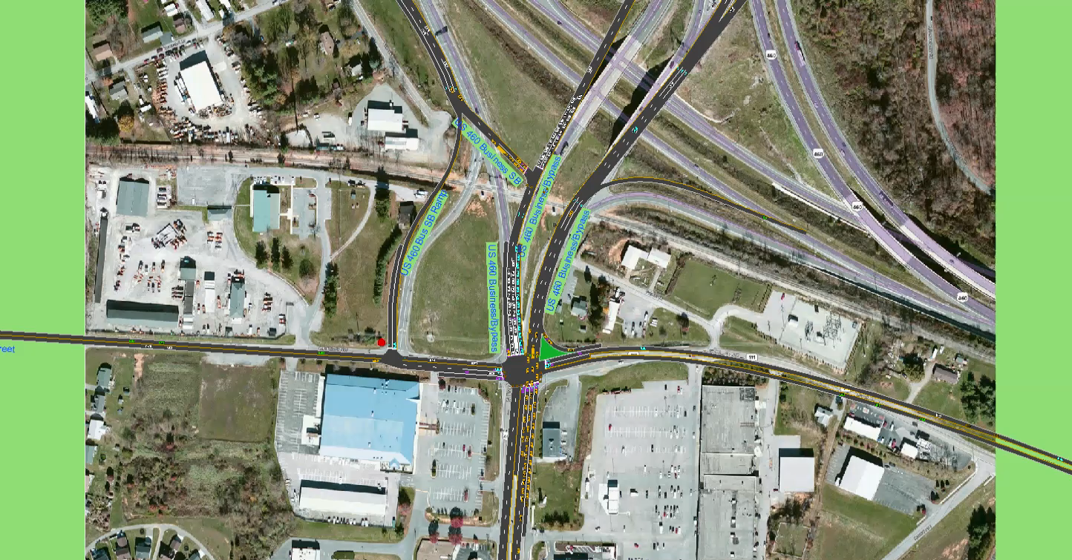
2040 Alt 2b PM Peak

